Slide 1
Welcome to Maple Class Years 3&4 parents
Class Teachers – Mr. Gachowicz & Miss. Claxton
Class Support staff – Mrs. Wallis

Slide 2
Maple Class Weekly Timetable
 | Monday | Tuesday | Wednesday | Thursday | Friday
8.30 – 9.15 | Registration/EMW | Registration/EMW | Registration/EMW | Registration/EMW | Registration/EMW
AM 1 9.15-10.00 | TT & Maths | TT & Maths | TT & Maths | TT & Maths | Yr.3 PE (Dance) Yr.4 Computing/IT
AM 1 10.00 – 10.45 | English | English | English | English | Tackling Tables Tests Spelling Tests
10.45-11.00 | Break | Break | Break | Break | Break
AM 2 11.00-12.00 | Guided Reading Handwriting/Spelling Rules | Guided Reading | Guided Reading | Music | Yr.4 PE (Dance) Yr.3 Computing/IT
12.00-13.00 | Lunch | Lunch | Lunch | Lunch | Lunch
13.00-13.15 | Registration/Independent Read | Registration/Independent Read | Registration/Independent Read | Registration/Independent Read | Registration/Independent Read
PM 1 13.15-14.20 | Science | Yr. 3 PE Yr.4 RSE/PSHE | EGPS | Art/DT | MFL
PM 2 14.20 – 15.00 | History/Geography | Yr. 4 PE Yr.3 RSE/PSHE | Outdoor Learning | RE | Homework Out Collective Worship (Sharing)
PM 2 15.00-15.15 | Collective Worship | Collective Worship (Singing) | Collective Worship | Collective Worship | Collective Worship (Sharing)

Slide 3
Maple Class Weekly Timetable
Tackling Tables are practised daily for fluency and help master multiplication and division facts
Whole class guided reading sessions 3xper week
PE twice a week so please ensure a suitable outdoor and indoor PE kit are at school at all times
Swimming will be in the Spring Term. Swimming happens on a Friday.
Music recorders will resume, and Maple class will have this once a fortnight on a Thursday morning for music.
EMW – Early morning work from 8.30am – registration

Slide 4
Maple Class Weekly Timetable
We will continue to use Mount Amelia, the local area and the school for outdoor learning, once a week, on a Wednesday afternoon.
Daily collective worship for the whole school will be at 3.00 pm

Slide 5
Equipment
Please ensure all school uniform and PE kits are clearly named
Please make sure a pair of wellies are at school all the time for wet play and outdoor learning
Waterproof trousers and jacket are no longer provided for wet play and outdoor learning
Equipment for lessons is all provided so no pencil cases needed
Suitable wear for the time of the year
Please send in communication diaries and reading books everyday
Please send children in with a drinks bottle – water

Slide 6
Homework
Homework is set on a Friday and returned the following Wednesday.
Homework is a grid system where children can opt to choose what they do each week.
Spellings are set at the start of each term and week by week dated, they follow age-appropriate spelling rules and national curriculum spellings
Spellings can also be found weekly on SpellingShed
Children each have a Log-in username and password for SpellingShed and Tackling Tables online and can be found in their communication diary
At KS2, it is expected that children read a minimum of 15 minutes every day and then record this in their communication diary
It is expected that children practise their times tables daily in a variety of ways

Slide 7
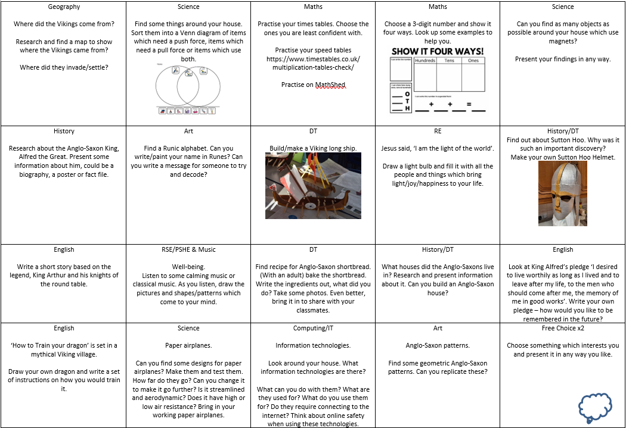
Homework Grid

Slide 8
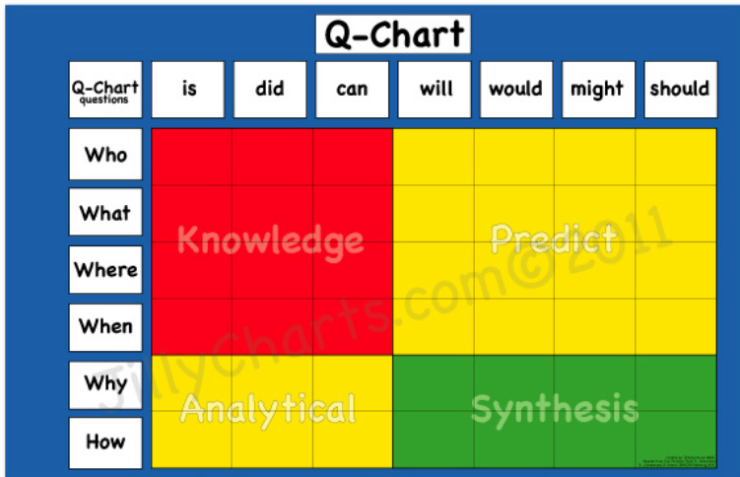
Reading

Slide 9
Snack/Lunch
At KS2 children no longer are provided with a snack for break time.
KS2 eat the second half of lunch time at 12.30

Slide 10
Intervention/Catch-Up Provision
Daily maths intervention if needed
Maths top up provision
Handwriting
Spellings
Times Tables Games
Memory Games
Guided Reading Groups/Comprehension groups
Daily Readers
Individual readers
SoundDiscovery

Slide 11
Rewards
Pupil of the Day
Star of the Week – presented in Sharing Collective Worship
Team Points
Good deeds jar
Rewards are given for good work, correct behaviour, kind deeds, positive attitude, being helpful, working hard etc

Slide 12
Year 4 MTC
Children will be tested on all their times tables up to 12x12 with an emphasis on the 6, 7, 8, 9 and 12 times tables
Takes place in June
An online, digital format test
Spring term daily practise speed tables

Slide 13
Trips this year
Autumn term – West Stow Anglo-Saxon village
Spring term – How Hill Residential
Summer Term – Hunstanton Day Trip
- Whole school trip

Slide 14
Contact
Any queries please don’t hesitate to get in contact
Email – maple@ingoldisthorpe.norfolk.sch.uk

